Slide 2
Where’s WikiLeaks?

Slide 3
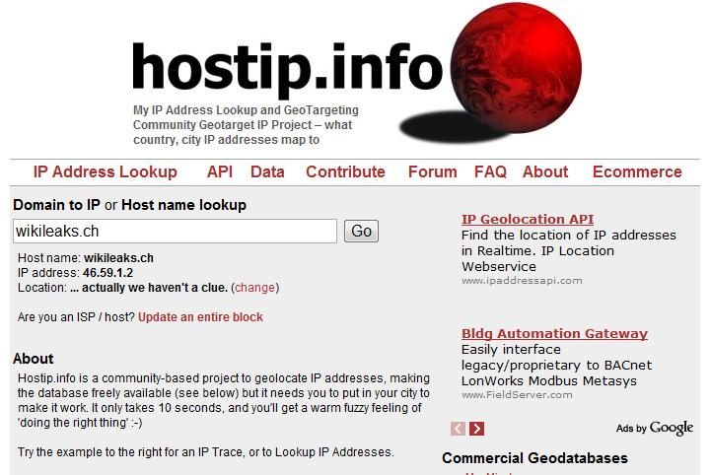

Slide 4
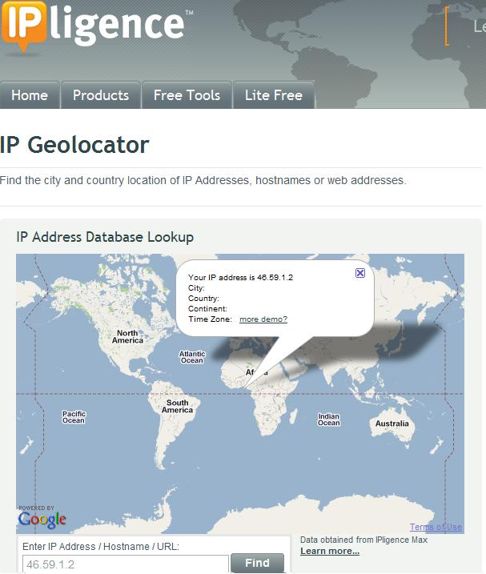

Slide 5
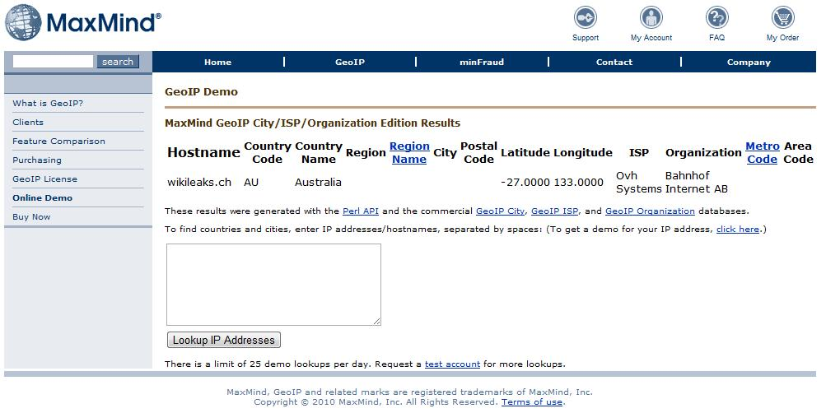

Slide 6
Spotter:
GEOLOCATION SERVICE
S. Laki*, P. Mátray, P. Hága, T. Sebők, I. Csabai, G. Vattay
A Model Based Active Geolocation Service
Sándor Laki*
Eötvös Loránd University
Budapest, Hungary
lakis@inf.elte.hu
The Project was supported by the European Union and co-financed by the European Social Fund (grant agreement no. TAMOP 4.2.1./B-09/1/KMR-2010-0003).

Slide 7
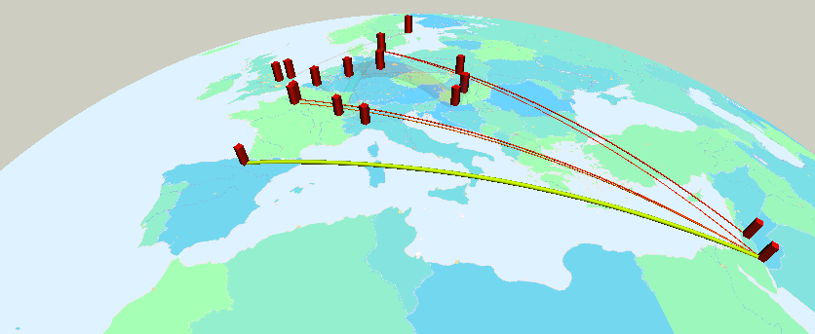
Motivation
Location information can be useful for both private and corporate users
Targeted advertising on the web
Restricted content delivery
Location-based security check
Scientific applications
Measurement visualization
Network diagnostics
Analysing spatial properties
of the Intenet

Slide 8
IP Geolocation in general
Passive Geolocation
Active Geolocation
Geolinguistic
Registry based
Whois, dns
Organizational infromation
Commercial databases
Maxmind, IPLigence, IP2Location, etc.
rt1.lon.uk.geant2.net
London, UK

Slide 9
IP Geolocation in general
Passive Geolocation
Active Geolocation
Geolinguistic
Registry based
Whois, dns
Organizational infromation
Commercial databases
Maxmind, IPLigence, IP2Location, etc.
rt1.lon.uk.geant2.net
Large and geographically dispersed IP blocks can be allocated to a single entity

Slide 10
IP Geolocation in general
Passive Geolocation
Active Geolocation
Geolinguistic
Registry based
Whois, dns
Organizational infromation
Commercial databases
Maxmind, IPLigence, IP2Location, etc.
Active probing
Delay, topology, etc.
Landmarks
With known location
Location estimates for each individual IP addresses
rt1.lon.uk.geant2.net
Large and geographically dispersed IP blocks can be allocated to a single entity

Slide 11
Active geolocation
?
Target
to be localized

Slide 12
Active geolocation
Landmarks with known location

Slide 13
Active geolocation
1010 ms
200 ms
501 ms
898 ms

Slide 14
Active geolocation
Transforming delays to geographical distances

Slide 15
How to transform network delays to geographical distances?

Slide 16
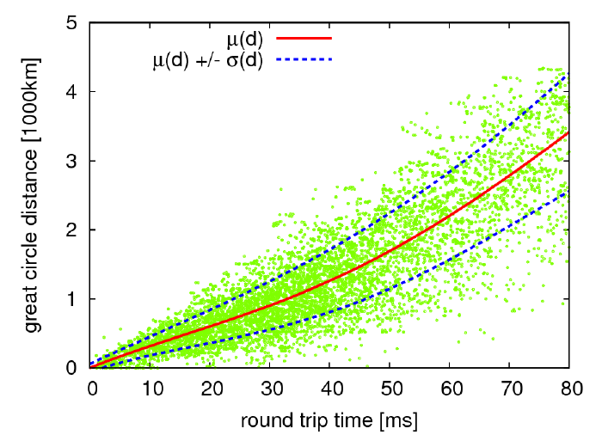
Our delay–distance model
Reference data set
Nodes with known location
~700 PlanetLab nodes
All to all RTT measurements
mininmum delays

Slide 17
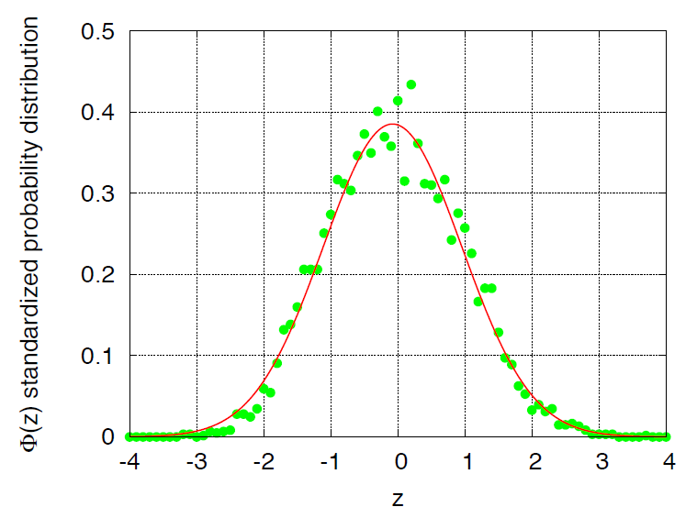
Our delay-distance model
Standardized values, fitted normal distribution
Approximated by a standard normal distribution
Geographic distances follow normal distribution
with parameters µ(t) and (t) for a given delay t

Slide 18
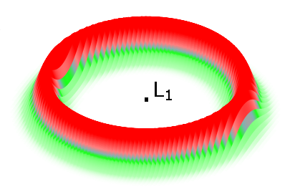
Evaluation
The distances are normally distributed for a given RTT
For each RTT the radial profile is approximated by a normal distribution (μ(d) and σ(d)) => which defines the spatial probability distribution of the target

Slide 19
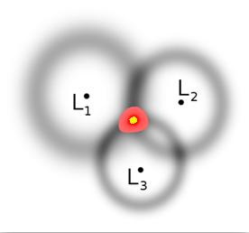
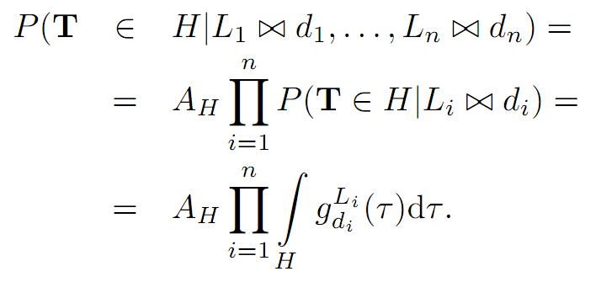
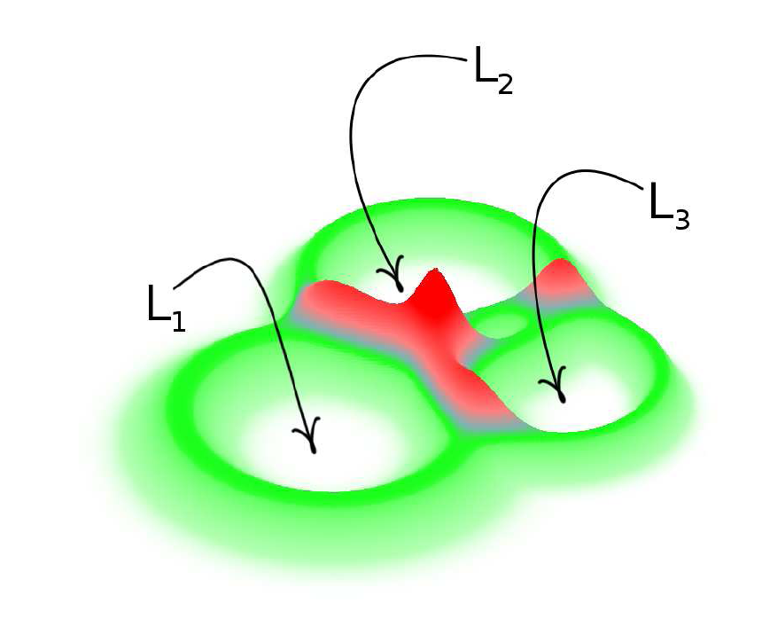
Evaluation – „Triangulation”
Landmarks: L₁, … , L_{n}
Delay d_{i} from L_{i} to T: L_{i} d_{i}
The probability that target T resides in region H:

Slide 20
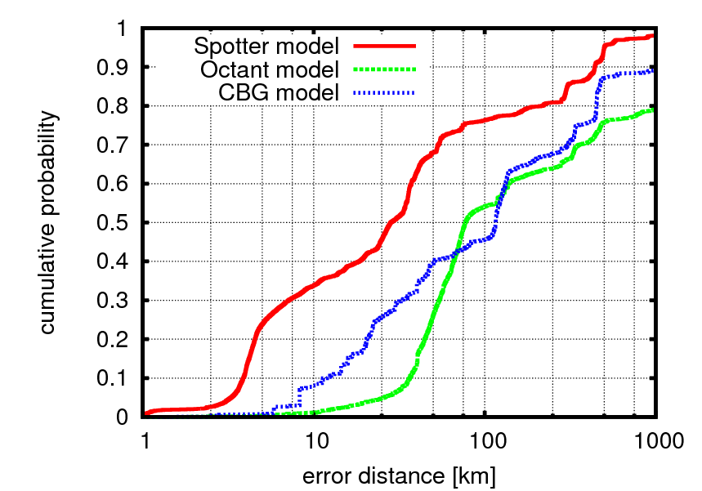
Performance analysis
Estimated accuracy for a geolocation ground truth
CAIDA’s Geolocation Comparision Survey
More than 20000 reference nodes
Located in North America and in Europe
In North America
70%
35%
40%
9%
27%
2%

Slide 21
The Online service

Slide 22
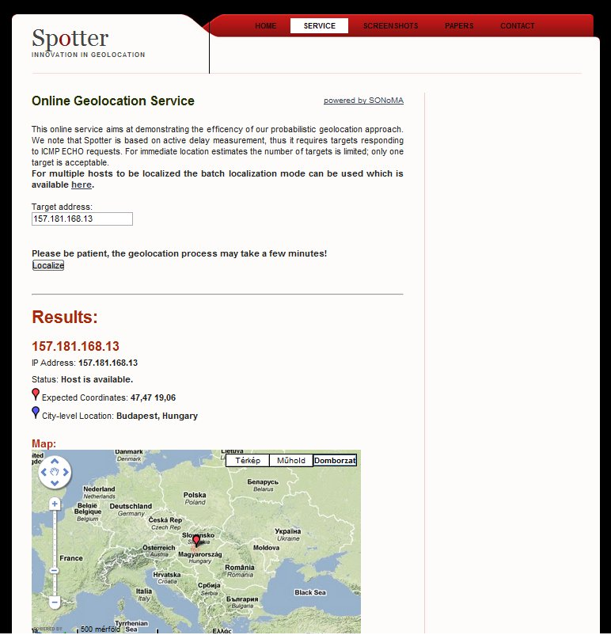
Spotter - The geolocation service
online: free, easy to use
~100 landmarks
Real time measurements in the background
offline: batch mode
~50k addresses/day
Full landmark set
~700 nodes
to fix:
DNS resolve problem
Sequential queuing
visit and use! http://spotter.etomic.org

Slide 23
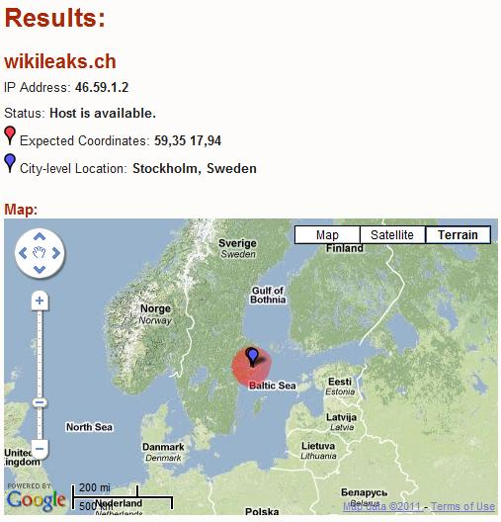
Where’s WikiLeaks?

Slide 24
Conclusion
Spotter is a measurement based geolocation service available online
Based on a probabilistic approach
A novel description of delay-distance relation
Validated on CAIDA’s Geolocation Ground Truth
30 km and 75 km median accuracy in North America and in Europe, resp.
New challenges:
IPv6, Real time measurements, etc
The Internet topology and the delay characteristics could be changed in the future

Slide 25
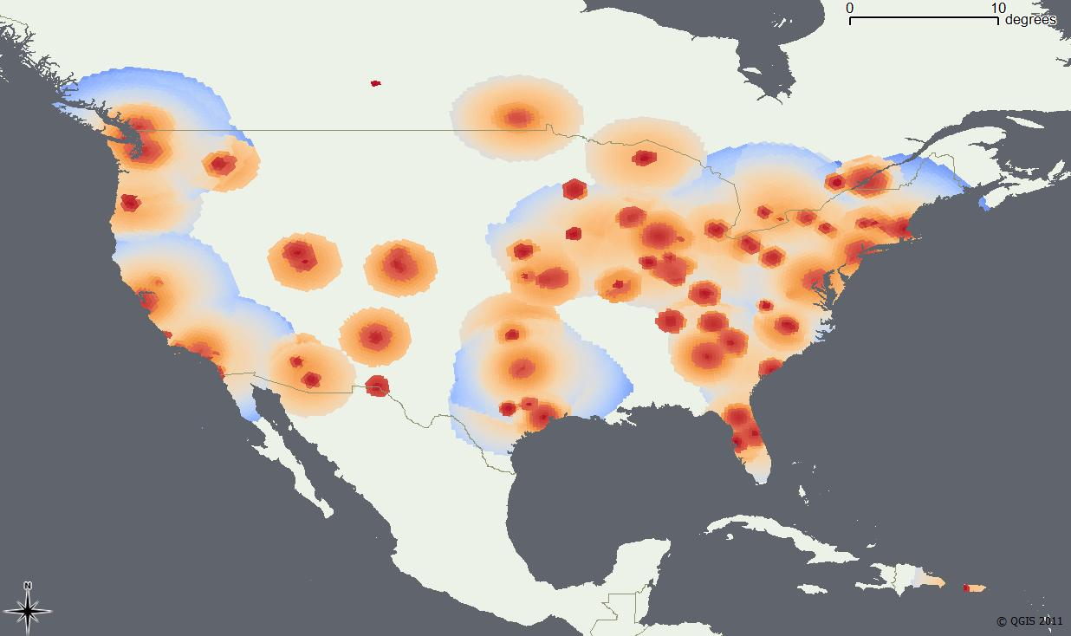
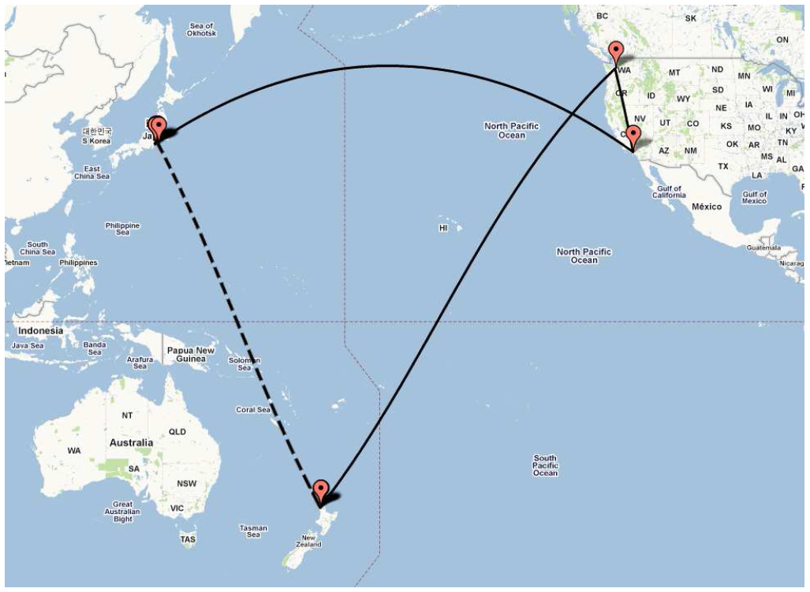
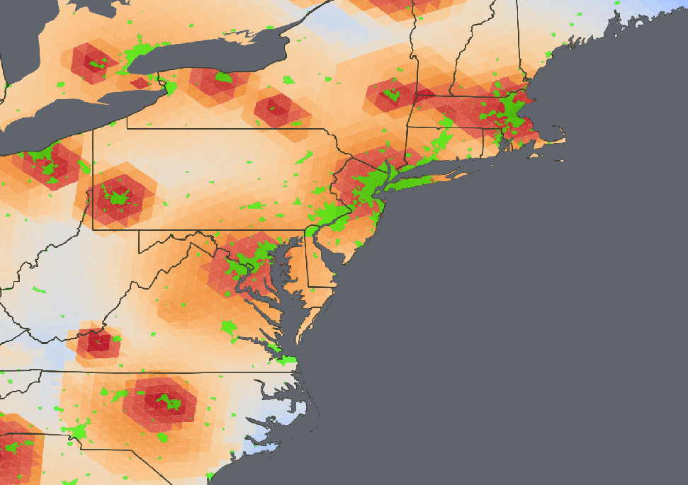
GEOLOCATION SERVICE
Thank you for your attention!
For more info please visit
http://spotter.etomic.org
or send me an email
lakis@inf.elte.hu (Sándor Laki)

