Slide 1

A Detailed Path-latency Model for Router Geolocation
Sándor Laki*, Péter Mátray, Péter Hága,
István Csabai and Gábor Vattay
Department of Physics of Complex Systems
Eötvös Loránd University
Budapest, Hungary
*E-mail: laki@complex.elte.hu

Slide 2
Agenda
Introduction
Path-latency Model
Velocity of Signal Propagation in Network
Geographic Constraints
Data Collection
Performance Analysis
Summary

Slide 3
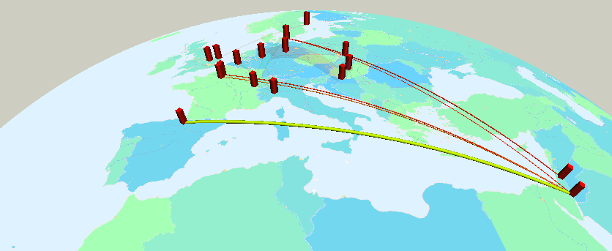
Motivation
Location information can be useful to both private and corporete users
  Targeted advertising on the web
  Restricted content delivery
  Location-based security check
  Web statistics
Scientific applications
  Measurement visualization
  Network diagnostics
Notes:
In recent years, new location aware applications have been appeared.
e.g….
The localization of IP addresses became important in scientific areas as well.
e.g. to visualize the results of Internet measurements
Network diagnostics:
For an ISP it can be helpful to know the geographic aspects of its network traffic.

Slide 4
Geolocation in General
Passive geolocation
  Extracting location information from domain names
  DNS and WhoIS databases
  Commercial databases
    MaxMind, IPligence, Hexasoft
  Large and geographically dispersed IP blocks can be allocated to a single entity
Active geolocation
  Active probing
  Measurement nodes with known locations
  GPS-like multilateration (CBG)

Slide 5
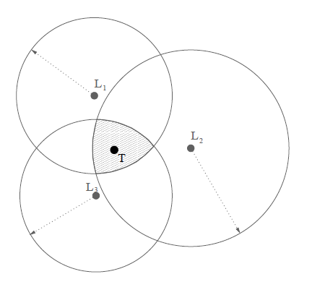
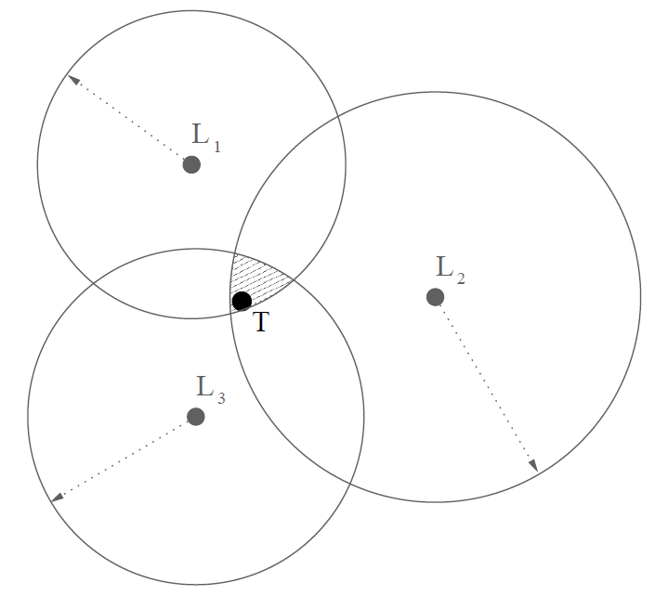
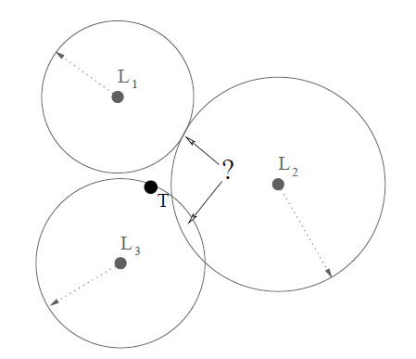
Measurement Based Geolocation
Active measurements
  Network Delays
    Delays can be transformed to geographic distance
      Round Trip Time (ping)
      One-way delay
    Effects of over and underestimation
  Topology
    Network-path discovery
      Traceroute with fixed port pairs
    Interface clustering
      Mercator, etc.

Slide 6
Presentation Outline
Introduction
Path-latency Model
Velocity of Signal Propagation in Network
Geographic Constraints
Data Collection
Performance Analysis
Summary

Slide 7
Why do we need a latency model?
The basis of active methods is to transform delays to geographic distance
The model aims to decompose the overall packet delay to linkwise components
Approximating propagation delays along a network path
leads to more precise distance estimations...

Slide 8
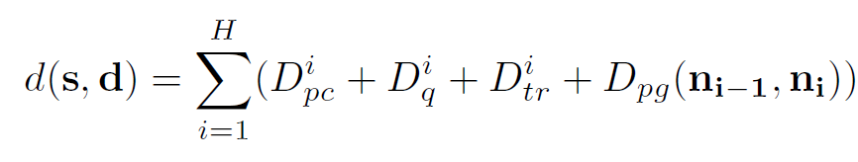
Modelling Packet Delays
A packet delay (d) can be divided into…
  Queuing delay (D_{q})
  Processing delay (D_{pc})
  Transmission delay (D_{tr})
  Propagation delay (D_{pg})
Only the propagation component has role in the geolocation
n₀
n₁
n₂
n_{H}
A given path:
The overall packet delay for a network path (s=n₀ and d=n_{H}):
…
Notes:
It’s a well-known fact that…

Slide 9

How to Estimate Propagation Delays
Assumptions in the model
  No queuing (D_{q} = 0)
  The per-hop processing and transmission delays can be approximated by a global constant (d_{h})
    d_{h} = D_{pc} + D_{tr}
  Based on the literature and our observations:
        d_{h} = 100μs
The one-way propagation delay along a given path:

Slide 10
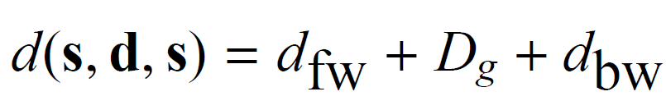
An Extra Cost - ICMP Generation Time
In case of ICMP based RTT measurements an extra delay appears at the target node
  ICMP Echo Reply Generation Time (D_{g})
The overall Round Trip Delay:
Is it possible to measure this D_{g} delay component?
Yes, there’s a way…

Slide 11
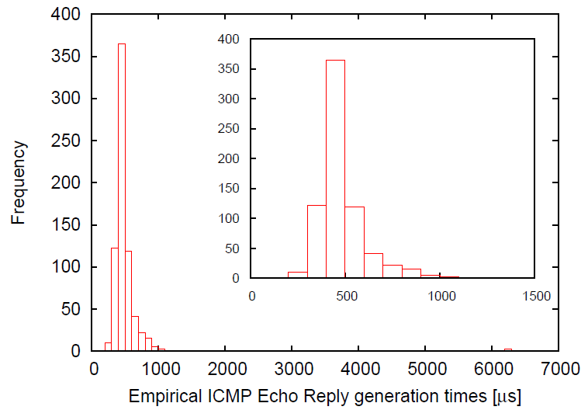
ICMP Generation Times
D_{g} = 300 μs
to avoid distance underestimation
Less than 1%
Notes:
We performed several experiments in Geant2. The empirical values are shown in this histogram where each bin is 100 us wide.
More than the 99% of the measured values are above 300 us. To avoid underestimation this quasi minimum value was used in our model.
This result is in accordance with the literature.

Slide 12
Presentation outline
Introduction
Path-latency Model
Velocity of Signal Propagation in Network
Geographic Constraints
Data Collection
Performance Analysis
Summary

Slide 13
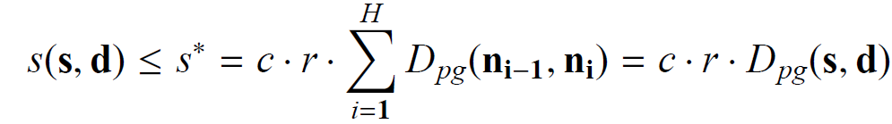
Distance Approximation
An upper approximation of geographical distance from source s to destination d:
Network cables not running straight due to several reasons
where r is the velocity of signal propagation in network [in c units]
d
Physical properties of the network cables
s
Notes:
To determine the relation between propagation delay and physical distance we need to determine an effective velocity considering a few things.
In radio communication, where the basis of geolocation came from, the signal travels straight as the crow flies at almost the speed of light in vacuum.
But in wired or heterogen networks there’s many things to be consider.

Slide 14
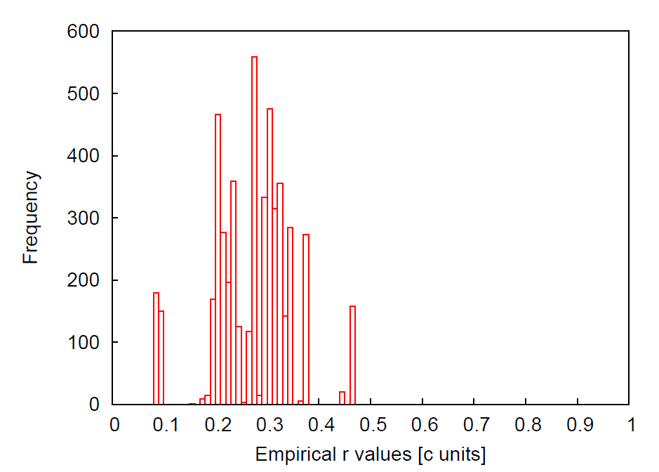
Signal Propagation in Network
And the average value was 0.27
The maximum velocity we measured in network was 0.47!
The maximum value was used to avoid distance underestimation
The velocity of signal propagation in a copper cable is ~0.66-0.7!
Notes:
For comparison the velocity in a copper cable is...
The reason of this large difference is the large number of curvatures in Internet due to policy routing and practical reasons.

Slide 15
Presentation outline
Introduction
Path-latency Model
Velocity of Signal Propagation in Network
Geographic Constraints
Data Collection
Performance Analysis
Summary

Slide 16
Solving Geolocation
Defining geographic constraints
We are looking for a location set where all the constrains come true
Defining the overall tension in the system
  A cost function
By minimizing this function the problem can be
solved
        Non-convex optimization problem
          Well known solutions in sensor networks

Slide 17
Round-Trip Time Constraint
Using path-latency model
  Round-trip propagation delay from a landmark
    Upper approximation of one-way propagation delay
The node
to be localized
t
L
Landmark
with known location

Slide 18
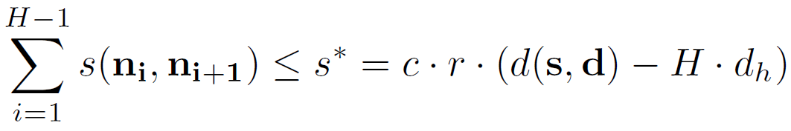
One-way Delay Constraint
A novel constraint for a network path between two landmarks
  Limiting the geographic length of a given network path
High-precision
OWD measurements
n₂
L₂
n₃
L₁
n₁

Slide 19
Presentation outline
Introduction
Path-latency Model
Velocity of Signal Propagation in Network
Geographic Constraints
Data Collection
Performance Analysis
Summary

Slide 20

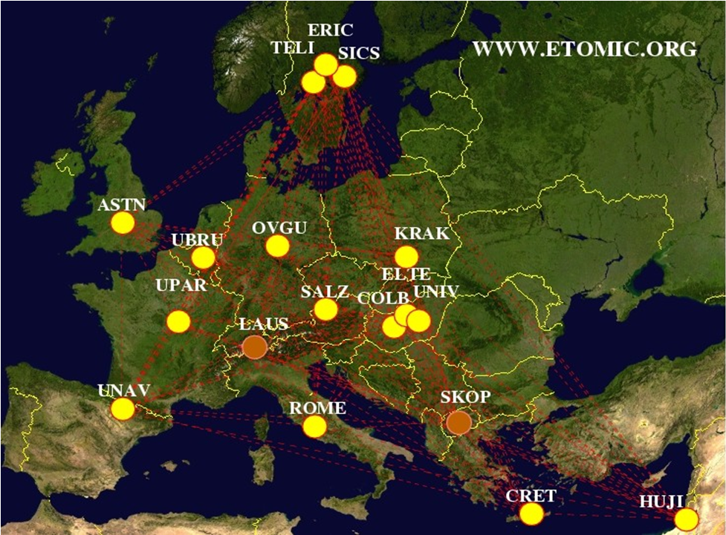

An Award-winning Testbed
European Traffic Observatory Measurement InfrastruCture (etomic) was created in 2004-05 within the Evergrow Integrated Project.
    Open and public testbed for researchers experimenting the Internet
    18 GPS synchronized active probing nodes
    Equiped with Endace DAG cards
      High-precision end-to-end measurements
Scheduled experiments
    NO SLICES
        You own the resources
        during the
        experimentation
Best Testbed Award
www.etomic.org

Slide 21
Presentation outline
Introduction
Path-latency Model
Velocity of Signal Propagation in Network
Geographic Constraints
Data Collection
Performance Analysis
Summary

Slide 22
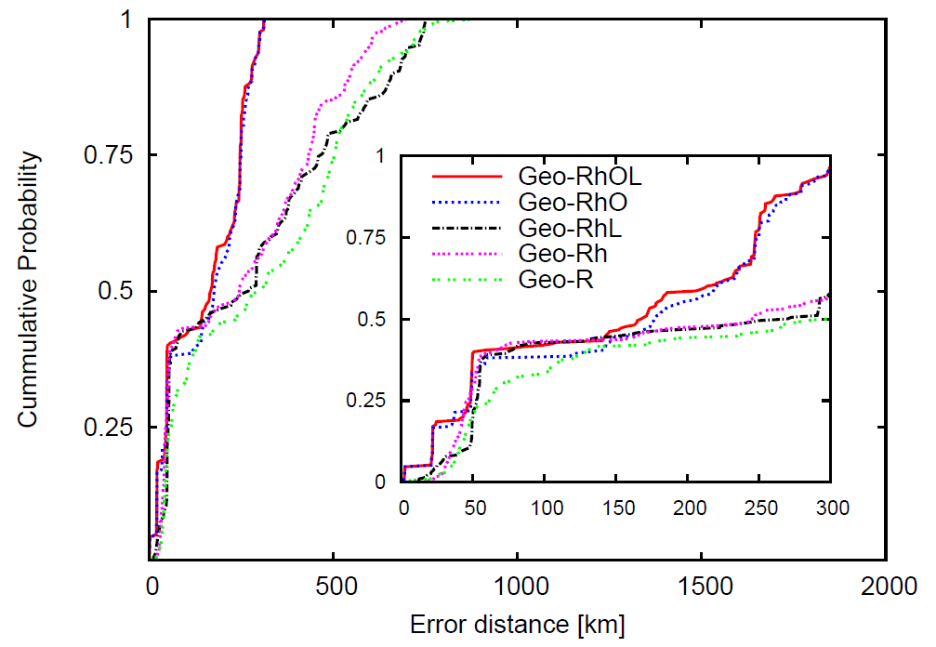
Performance Analysis
Geo-Rh
Mean error: 251 km
Max. error: 699 km
StdDev: 205 km
Geo-RhOL
Mean error: 149 km
Max. error: 312 km
StdDev: 104 km
Geo-R
Mean error: 305 km
Max. error: 878 km
StdDev: 236 km
Notes:
Geo-R:
In the simpliest case the overall delays were used as propagation delays and only the round-trip delay constraint was considered. We didn’t use the path-latency model in this scenario.
Geo-Rh:
Next, we also took into account our path-latency model to determine propagation delays. In this setting we used only the round trip delay.
Geo-RhOL:
In the final scenario we used all the introduced constraints. It can be seen that the owd constraint can improve the accuracy significantly especially in case of maximum errors.

Slide 23
Presentation outline
Introduction
Path-latency Model
Velocity of Signal Propagation in Network
Geographic Constraints
Data Collection
Performance Analysis
Summary

Slide 24
Summary
Estimating propagation delays more precisely
  Separation of propagation and per-hop delays in the overall packet latency
Velocity of signal propagation in network is much smaller than we assumed before due to curvatures
The novel one-way delay constraints improve the accuracy of router geolocation significantly
  Nowadays these measurements are available in a few NGN testbeds (ETOMIC, new OneLab-2 nodes, etc.)
Plans for future extensions
  The method can be combined with passive techniques
  Improving latency model

Slide 25
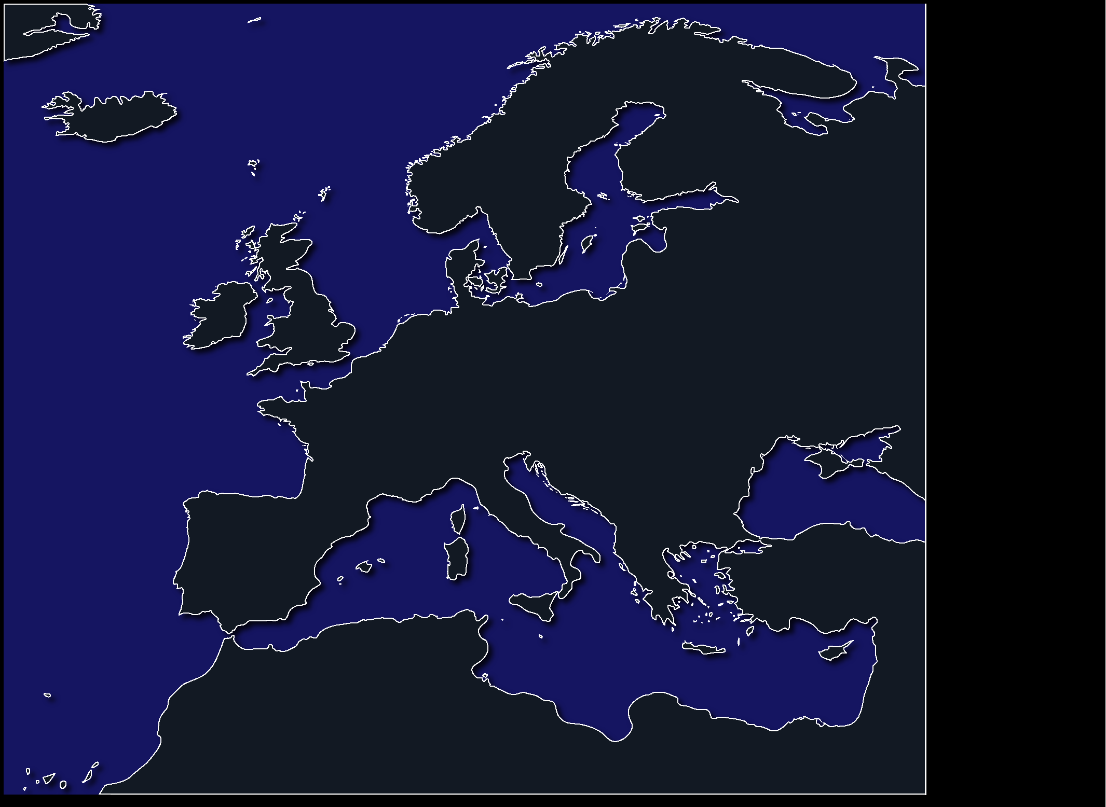




OneLab2 - The Next Generation of ETOMIC
OneLab2 sites:
  ≥2 PlanetLab nodes
  New features
    Dummybox
    WiFi access
    UMTS, WiMax…
  1 ETOMIC2-COMO
  integrated node
    High precision e2e measurements
    ARGOS meas. card
    available via ETOMIC’s CMS
  1 APE box
    A lightweight
    measurement tool
ETOMIC
www.etomic.org
OneLab2
www.onelab.eu
www.etomic.org
Notes:
OneLab-2 nodes will extend the number of high-precision landmarks
Federated with Planetlab Europe.

Slide 26





Thank you for your attention!
Contact: laki@complex.elte.hu
This work was partially supported by the National Office for Research and Technology
(NAP 2005/ KCKHA005) and the EU ICT OneLab2 Integrated Project
(Grant agreement No.224263).
Notes:
The end…

